Slide 1
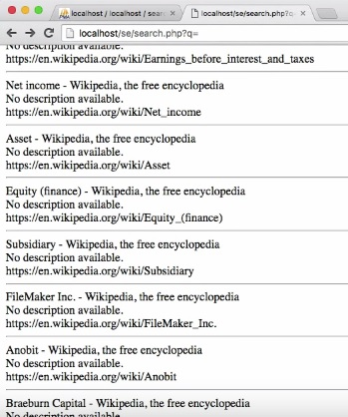
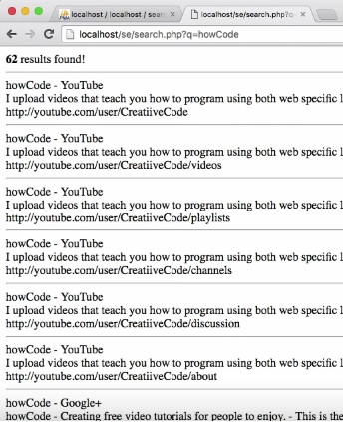
Creating a Simple Search Engine
Here’s the first look
querying, “howCode”,62 results found.

Slide 2
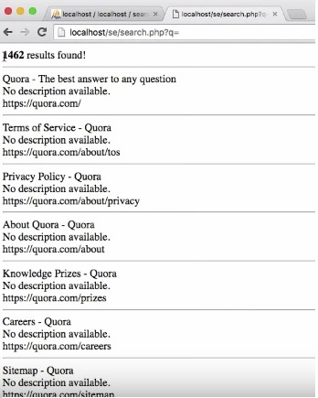
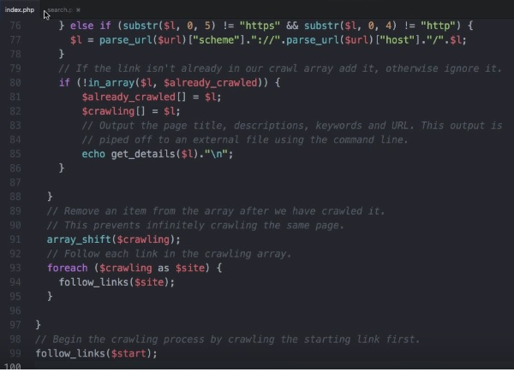
After passing a query sample
Search engine would be comprising of two pages.

Slide 3
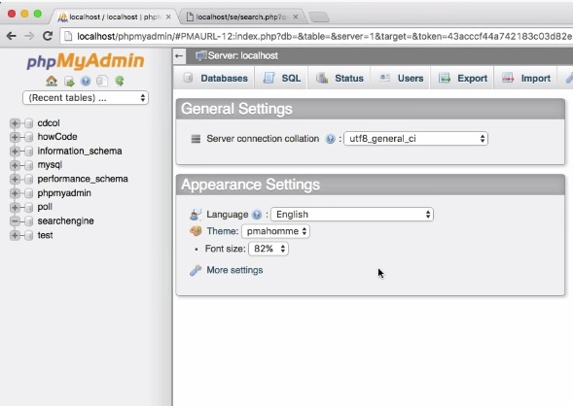
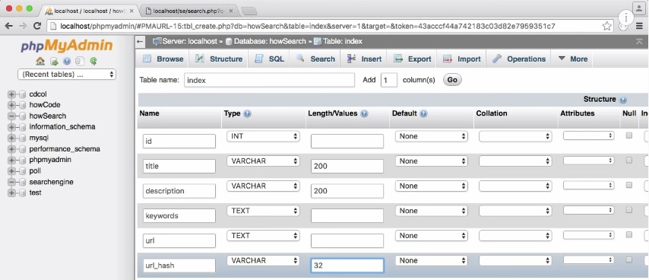
Creating a Database:
we create a table and call it index. We would have 6 columns for the table namely: ID, Title, Description, Keywords ,URL, URL-hash

Slide 4
In the next session, we'll probably modify our crawler to insert it's results into our database and after that we'll be creating the search engine.

